Slide 2
Chapter 3
Section 2
The Kingdom of Israel

Slide 3
The Israelites Choose a King
Around 1000 BC the Philistines were the strongest people in Canaan, not the Israelites. The Philistines built strong cities and had iron weapons.
The Israelites began to copy the Philistine’s religion, so many Israelites thought a king of their own would prevent this from happening.
An Israelite king would also unite their own tribes.

Slide 4
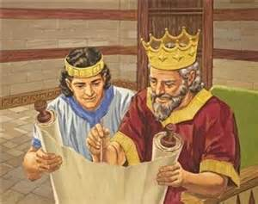
The Rule of King Saul
Around 1020 BC Israelites asked Samuel (a judge and prophet) to choose a king.
Samuel chose Saul a warrior-farmer.
Saul defeated Israel’s enemies but disobeyed some of God’s commands.
God instructed Samuel to choose another king and anoint him in secret. His name was David.

Slide 5
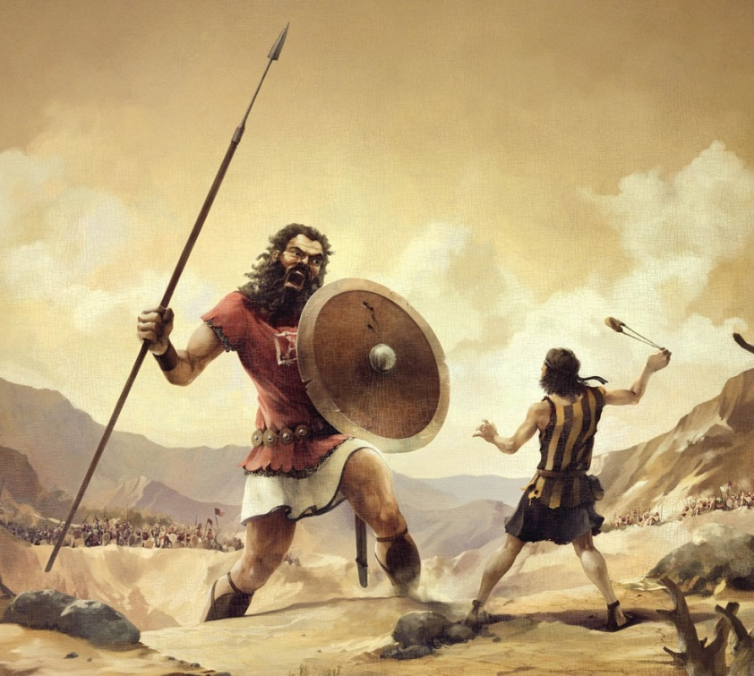
David was know for his
bravery and leadership.
Before a battle with the Philistines, David fought a giant named Goliath.
With his slingshot, David killed Goliath with a single smooth stone.

Slide 6
David and Solomon
David wasn’t able to become king until 1000 BC, but once in power he drove the Philistines out of the area which allowed him to create an empire for the Israelites.
Who Came First? (Click On Your Answer)
David Samuel Saul

Slide 7
Incorrect
Click to Return and Try Again

Slide 8
Correct !
Click to Continue

Slide 9
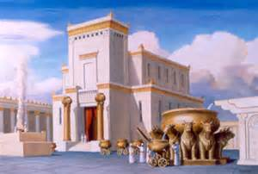
Israelites remember David as their greatest king, as Jews do today.
When David died, his son Solomon became king. Solomon finished building the famous temple in Jerusalem.
Click on picture for Spotlight Video

Slide 10
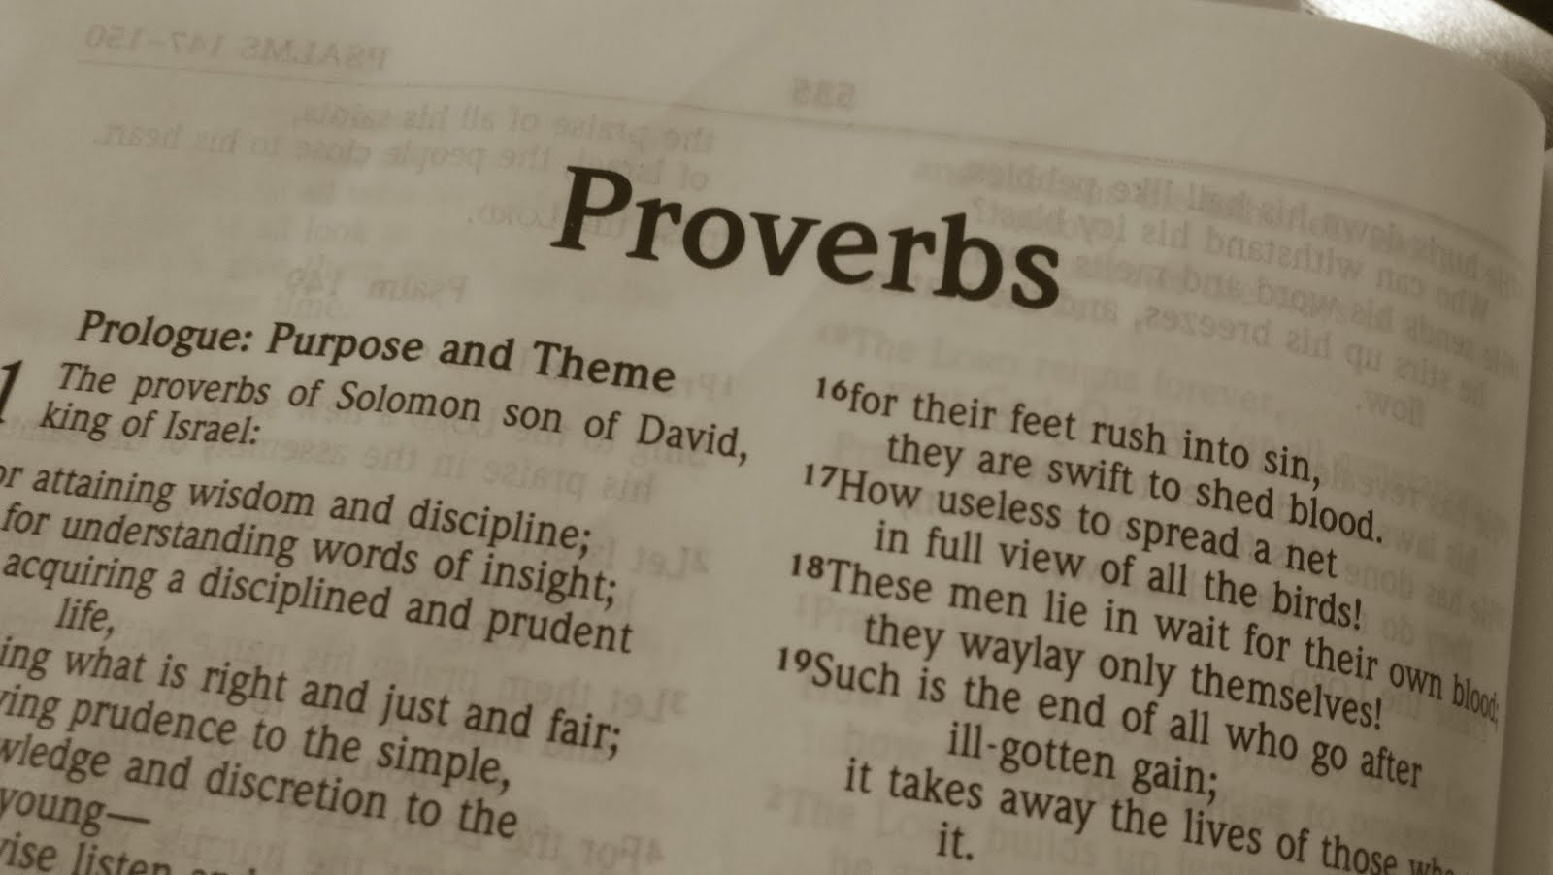
Solomon’s temple became a symbol and center of Jewish religion. Many Israelites did not like Solomon because he taxed them so much, to pay for his great buildings.
Solomon was also known for his wise sayings, or Proverbs.

Slide 11
Solomon made the Israelite men who couldn’t pay his high taxes to work in the salt mines.
This made Solomon very unpopular.
When Solomon died, the 12 tribes split up. 10 went to the north and formed the Kingdom of Israel. 2 went south and formed the smaller Kingdom of Judah.

Slide 12
Troubled Times
The kingdoms of Israel and Judah felt threatened by their powerful neighbors, the Assyrians and Chaldeans.
Who Were the Prophets?
During the troubling times people who became known as the Prophets brought hope to the people. The Prophets taught people to live moral lives.

Slide 13
What Caused
The Fall of Israel?
In 722 BC the Assyrians conquered Israel and scattered the 10 tribes. They became known as the Lost Tribes of Israel.

Slide 14
What Caused the Fall of Judah?
In 620 BC the Egyptians conquered Judah. Later still, the Chaldeans conquered Egypt.
Nebuchadnezzar treated the Jews harshly. The Jews planned a revolt, but it was stopped and Jerusalem was destroyed. The Jews were sent to Babylon in captivity. This time was known as the Babylonian Captivity.

